Slide 1




GRADE 9-10 · AP PRECALCULUS · UNIT 1
Topic 1.6
Polynomial Functions
and End Behavior
Journey of 6 stations, 60 minutes
Polynomial and Rational Functions
Mr Malek Thiab
FAITH, RIGHTEOUSNESS AND WISDOM
Notes:
Speaker notes: Welcome to Topic 1.6: Polynomial Functions and End Behavior.
Timing: 60 minutes (Diagnose 6, Targeted Instruction 18, Practice 12, Production 12, Mastery Gate 6, Smart Production 6). For a 40-minute class scale every station by two thirds.
The journey map on the next slide shows the six stations; in slideshow mode the Morph transition zooms the station circles into the breadcrumb at the top of every later slide.

Slide 2


Today's journey
Six stations. Each one zooms in as we arrive.
Targeted Instruction
18 min
Production
12 min
Smart Production
6 min
2
4
6
1
3
5
Diagnose
6 min
Practice
12 min
Mastery Gate
6 min
FAITH, RIGHTEOUSNESS AND WISDOM
Notes:
Speaker notes: This is the whole map. Walk it left to right: Diagnose (what we already know), Targeted Instruction (End behavior and limit notation; Degree and leading coefficient decide; Factored form and turning points), Practice (Practice, Apply, Investigate), Production (national park visitors), Mastery Gate (three questions to pass), Smart Production (create, then Time to Check).
In slideshow mode the Morph transition animates these circles shrinking into the breadcrumb on later slides; without Morph the slides fade.
Ask the class which station they think will be hardest.

Slide 3
What we are learning
OBJECTIVES
VOCABULARY
Describe end behavior of polynomial functions.
end behavior
degree
leading term
leading coefficient
limit notation
turning point
STANDARDS
LO 1.6.A Describe end behavior of polynomial functions.
LO 1.6.A
FAITH, RIGHTEOUSNESS AND WISDOM
Mr Malek Thiab · 3
Notes:
Speaker notes: Read the objectives aloud one at a time and have students say which one they feel least sure about.
Vocabulary used today: end behavior, degree, leading term, leading coefficient, limit notation, turning point.
Standards are listed on this slide.
The essential question and mathematical practices are not shown because they are not in the project documents; add them from the curriculum map if you want them displayed.

Slide 4
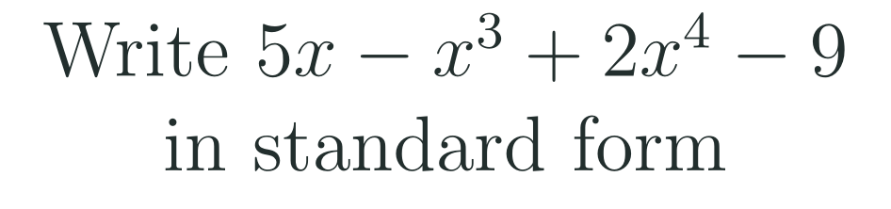
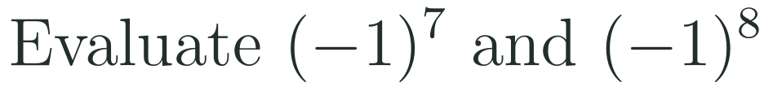
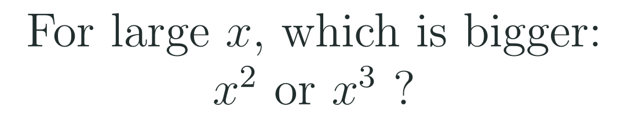
1
2
3
4
5
6
STATION 1 · DIAGNOSE · 6 MIN
Start here: three quick checks
1
2
3
Done when
All three answers are written without a calculator, and you can say which term of a polynomial matters most when x is very large.
LO 1.6.A
FAITH, RIGHTEOUSNESS AND WISDOM
Mr Malek Thiab · 4
Notes:
Speaker notes (Diagnose, 6 min, no calculator):
Speaker notes (Diagnose, 6 min, no calculator).
Solutions: Q1 2x^4 - x^3 + 5x - 9 (highest power first). Q2 (-1)^7 = -1 and (-1)^8 = 1. Q3 x^3 is bigger for large positive x (try x = 100: 10^6 against 10^4).
Verbal misconceptions: 'standard form means the order I was given', 'a negative base always gives a negative answer'. Say: the sign depends on whether the power is odd or even.
Adaptive routing: if more than 30% miss Q1, route to slide 5 (leading term first). If more than 30% miss Q2, route to slide 6 (odd and even powers). If Q3 is missed, show x = 100 on slide 5.

Slide 5

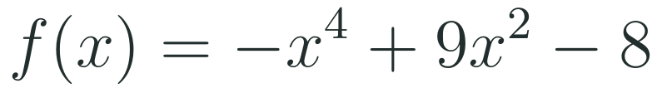
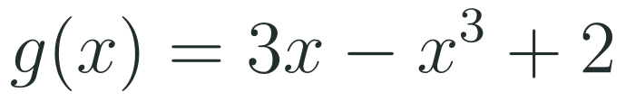
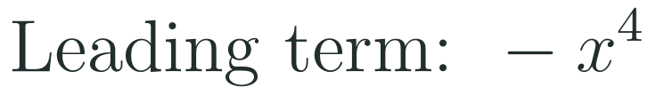

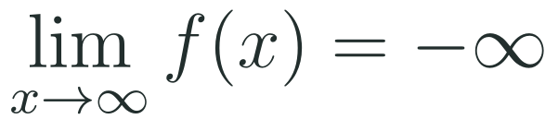
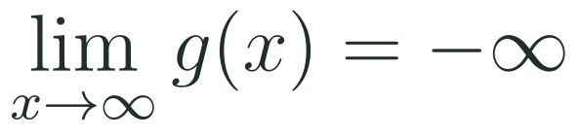
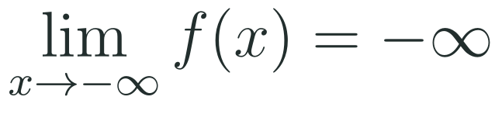
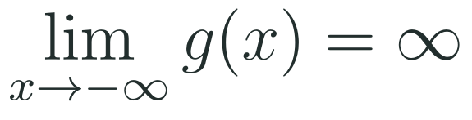
1
2
3
4
5
6
STATION 2 · TARGETED INSTRUCTION · 18 MIN
End behavior and limit notation
EXAMPLE A
EXAMPLE B
LO 1.6.A
FAITH, RIGHTEOUSNESS AND WISDOM
Mr Malek Thiab · 5
Notes:
Speaker notes (Targeted Instruction, block 1 of 3):
Speaker notes (Targeted Instruction, block 1 of 3).
Worked solutions: Example A: leading term -x^4. As x to infinity, -x^4 to -infinity; as x to -infinity, (-x)^4 is still positive so -x^4 to -infinity. Both ends down. Example B: reorder to -x^3 + 3x + 2. Leading term -x^3. As x to infinity, f to -infinity. As x to -infinity, x^3 is negative so -x^3 is positive, f to +infinity.
Verbal misconceptions: 'the middle hump decides the ends' (only the leading term decides far from zero); 'write f of infinity' (infinity is not an input, the limit describes a direction).
Adaptive routing: if more than 30% miss the Gate Q1, return to this slide and redo Example B aloud.

Slide 6
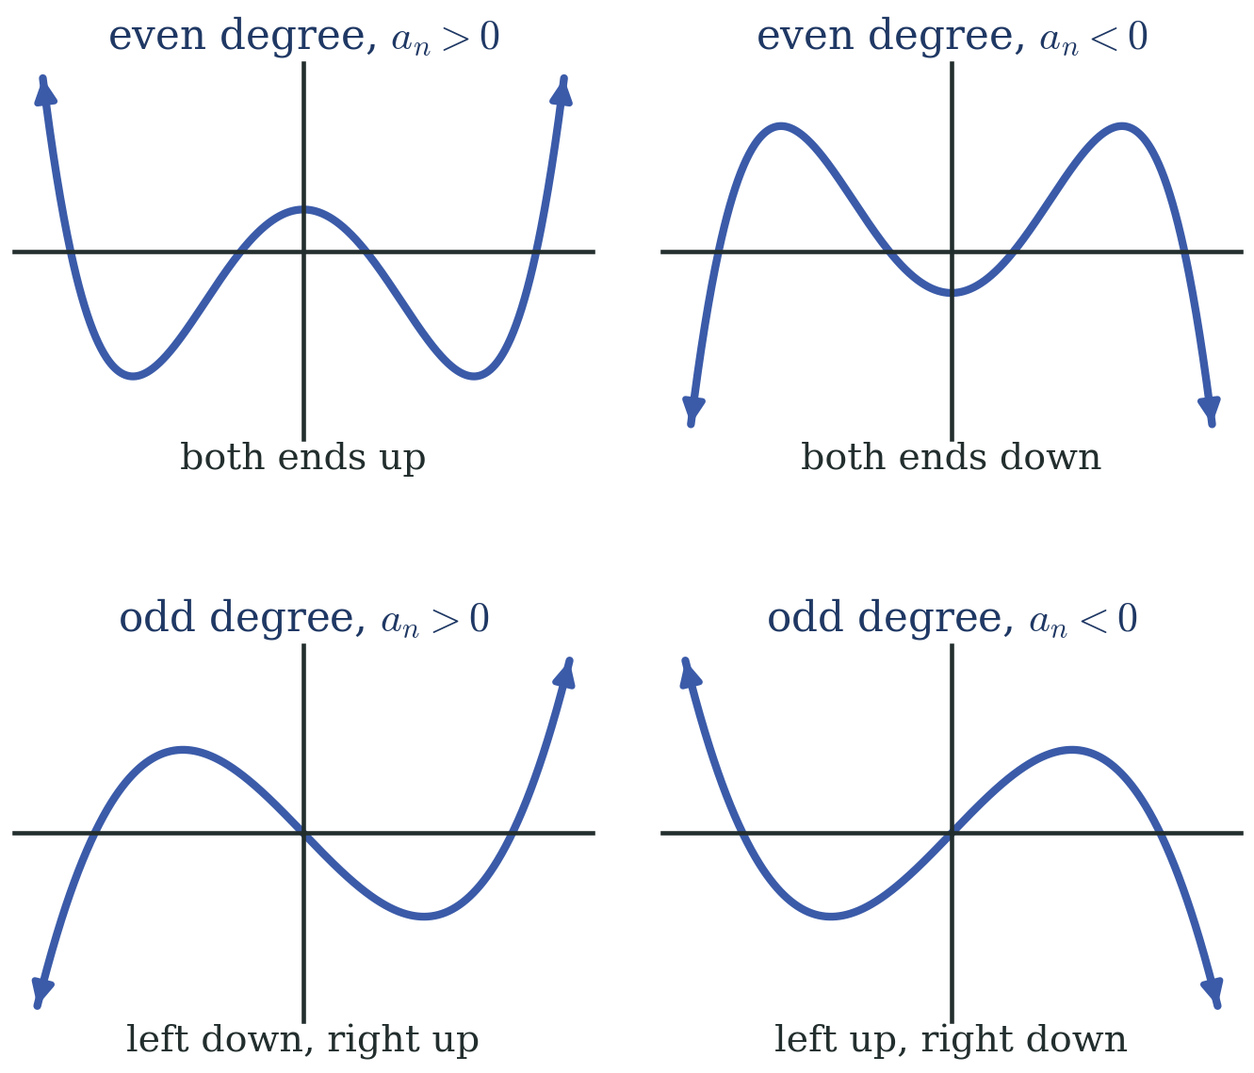
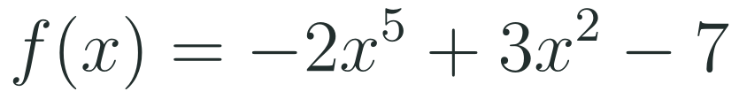
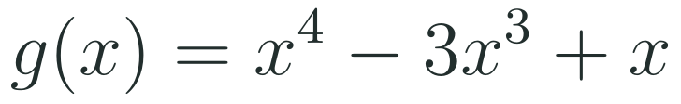


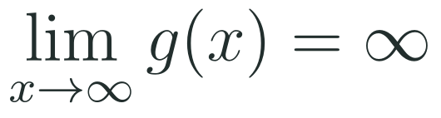
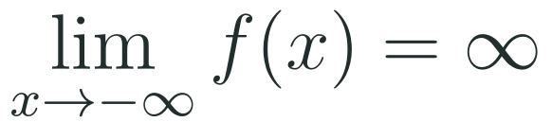
1
2
3
4
5
6
STATION 2 · TARGETED INSTRUCTION · 18 MIN
Degree and leading coefficient decide
EXAMPLE A
EXAMPLE B
LO 1.6.A
FAITH, RIGHTEOUSNESS AND WISDOM
Mr Malek Thiab · 6
Notes:
Speaker notes (Targeted Instruction, block 2 of 3):
Speaker notes (Targeted Instruction, block 2 of 3).
Worked solutions: Example A: -2x^5 has odd degree and negative coefficient, so the right end falls and the left end rises. Example B: x^4 has even degree and positive coefficient, so both ends rise. Use the four panels in the figure to match each pair of limits to a picture.
Verbal misconceptions: 'negative always means both ends down' (only for even degree; for odd degree a negative coefficient swaps the ends); 'the other terms can change the ends' (they only change the middle).
Adaptive routing: if more than 30% miss Gate Q2, route back to slide 6 and ask students to sketch both ends before writing limits.

Slide 7
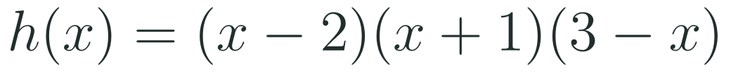
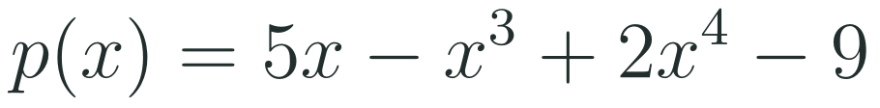

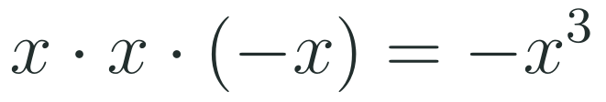
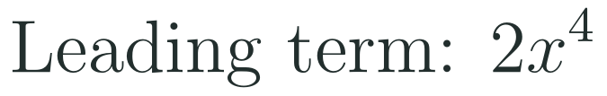
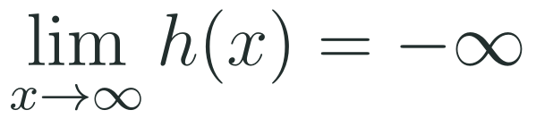



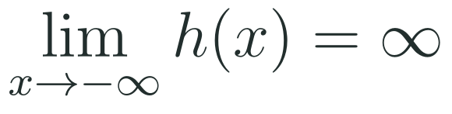
1
2
3
4
5
6
STATION 2 · TARGETED INSTRUCTION · 18 MIN
Factored form and turning points
EXAMPLE A
EXAMPLE B
EXAMPLE C
LO 1.6.A
FAITH, RIGHTEOUSNESS AND WISDOM
Mr Malek Thiab · 7
Notes:
Speaker notes (Targeted Instruction, block 3 of 3):
Speaker notes (Targeted Instruction, block 3 of 3).
Worked solutions: Example A: multiply the leading terms of the three factors: x * x * (-x) = -x^3, so odd degree, negative: left end up, right end down. Example B: reorder to 2x^4 - x^3 + 5x - 9, leading term 2x^4, both ends rise; degree 4 gives at most 3 turning points. Example C: degree 6 gives at most 5 turning points; both ends point the same way, so the number of turning points is odd: 1, 3, or 5.
Verbal misconceptions: 'the leading term is the first one written' (reorder first); 'exactly n-1 turning points' (it is at most n-1).
Adaptive routing: if more than 30% miss Gate Q3, route back to slide 7 Example C.

Slide 8
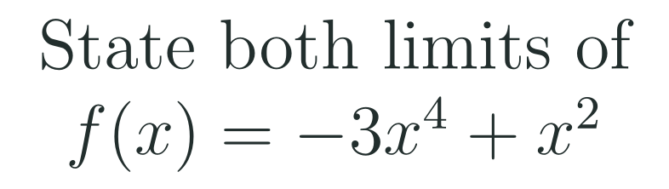
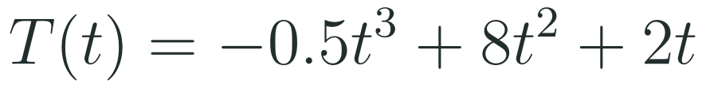
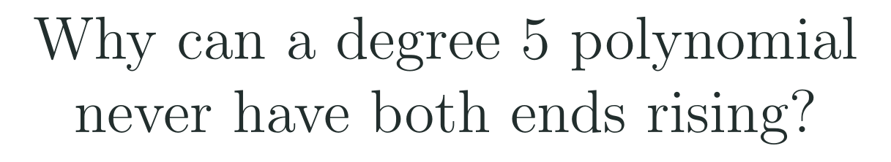
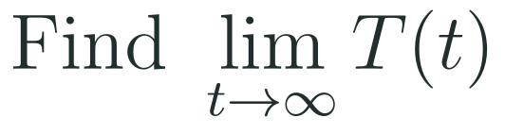
1
2
3
4
5
6
STATION 3 · PRACTICE · 12 MIN
Give it a go: Practice, Apply, Investigate
PRACTICE
APPLY
INVESTIGATE
Secure the method
Use it in context
Find out why
Done when: both limits are written in full limit notation and you can name the leading term.
Done when: you state the limit and say in one sentence what it means for the model.
Done when: your explanation uses what happens to odd powers of negative inputs.
LO 1.6.A
FAITH, RIGHTEOUSNESS AND WISDOM
Mr Malek Thiab · 8
Notes:
Speaker notes (Practice, 12 min; tierless differentiation: students choose the starting column and may move across):
Speaker notes (Practice, 12 min; tierless: students choose the starting column and may move across).
Answers: Practice: leading term -3x^4, limit as x to infinity is -infinity and as x to -infinity is -infinity. Apply: leading term -0.5t^3, limit as t to infinity is -infinity; the model eventually predicts negative values, which is impossible, so it cannot be used for all large t. Investigate: an odd power of a large negative input is negative, so a degree 5 polynomial with a positive leading coefficient falls on the left; with a negative one it falls on the right. One end always falls.
Verbal misconceptions: 'both ends of every polynomial go the same way'.
Adaptive routing: students who finish Practice move to Apply; stuck students return to slide 6.

Slide 9
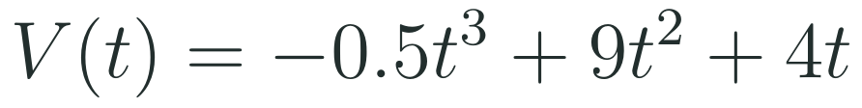

1
2
3
4
5
6
STATION 4 · PRODUCTION · 12 MIN
Production: national park visitors
THE MODEL
DONE WHEN
A national park models yearly visitors, in thousands, with a cubic function. The numbers below are model values for practice, not official forecasts. Time t is measured in years after 2025.
The limit is written in limit notation.
The maximum is given to three decimal places with units (thousands).
The year is stated as a calendar year, not just a value of t.
The explanation mentions that the model gives negative visitors.
Find the limit of V as t grows without bound.
Use a calculator to find the greatest number of visitors and the year it happens.
Explain why the model cannot be trusted for all large t.
Hint: press the maximum command on the graph, then add t to 2025.
LO 1.6.A
FAITH, RIGHTEOUSNESS AND WISDOM
Mr Malek Thiab · 9
Notes:
Speaker notes (Production, 12 min):
Speaker notes (Production, 12 min, calculator allowed).
Solutions: Task 1: leading term -0.5t^3, so V tends to -infinity as t tends to infinity. Task 2: V'(t) = -1.5t^2 + 18t + 4 = 0 gives t = 12.218 years; V(12.218) = 480.439 thousand visitors, about 480,439 visitors, in the year 2037 (2025 + 12.218 = 2037.218). Task 3: V(20) = -320, a negative number of visitors, which is impossible; the model first reaches 0 at t = 9 + sqrt(89) = 18.434, about 2043.
Verbal misconceptions: 'maximum value' versus 'time of the maximum' (two different answers); rounding t early.
Adaptive routing: if students cannot find the maximum, send them to slide 5 limit notation then the calculator hint.

Slide 10
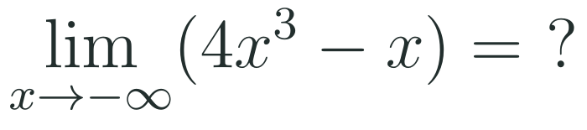
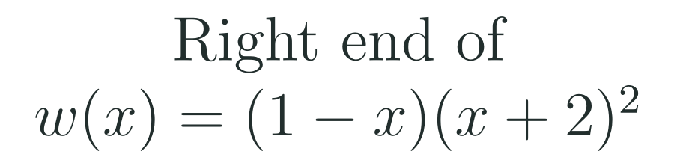
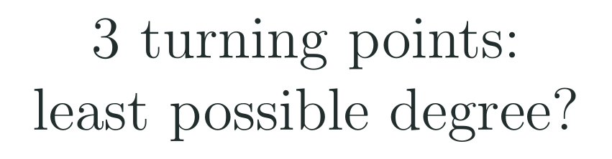
1
2
3
4
5
6
STATION 5 · MASTERY GATE · 6 MIN
Mastery Gate: three questions to pass
1
2
3
Pass mark
3 of 3 correct unlocks Station 6. Fewer than that: return to the slide for the question you missed, redo it, then re-take the gate.
LO 1.6.A
FAITH, RIGHTEOUSNESS AND WISDOM
Mr Malek Thiab · 10
Notes:
Speaker notes (Mastery Gate, 6 min, no calculator):
Speaker notes (Mastery Gate, 6 min, no calculator).
Answers: Q1 -infinity (odd degree, positive coefficient, left end falls). Q2 leading term (-x)(x^2) = -x^3, so as x to infinity w tends to -infinity. Q3 degree 4 (degree n has at most n-1 turning points, so n - 1 >= 3).
Verbal misconceptions: Q1 'x to negative infinity gives positive infinity because of the minus sign'; Q2 'the first factor decides'; Q3 'degree equals the number of turning points'.
Adaptive routing: Q1 missed, route to slide 5; Q2 missed, route to slide 7 Example A; Q3 missed, route to slide 7 Example C.

Slide 11
1
2
3
4
5
6
STATION 6 · SMART PRODUCTION · 6 MIN
Smart Production: make one, then check it
CREATE
TIME TO CHECK
Write a polynomial of degree 4 or 5 whose ends go in a given pair of directions.
Write its two limits in limit notation on the back.
Swap with a partner: they check the leading term and both limits.
Exit ticket: write your answer on a sticky note and place it on the door.
Done when: your partner confirms the degree, the sign of the leading coefficient and both limits.
Next lesson: Topic 1.7 Rational Functions and End Behavior.
LO 1.6.A
FAITH, RIGHTEOUSNESS AND WISDOM
Mr Malek Thiab · 11
Notes:
Speaker notes (Smart Production, 6 min):
Speaker notes (Smart Production, 6 min).
Exit answer: leading term -2x^3, so as x to infinity f tends to -infinity and as x to -infinity f tends to +infinity.
Verbal misconceptions: students write both limits equal to -infinity. Ask: what does x^3 do to a negative number?

Slide 12
Journey complete
Targeted Instruction
Production
Smart Production
✓
✓
✓
✓
✓
✓
Diagnose
Practice
Mastery Gate
Find the leading term, read the degree and the sign, and both ends of a polynomial follow.
FAITH, RIGHTEOUSNESS AND WISDOM
Notes:
Speaker notes: Every station is checked off. Recap in one sentence: Find the leading term, read the degree and the sign, and both ends of a polynomial follow. Collect the Time to Check responses. Next lesson: Topic 1.7 Rational Functions and End Behavior.

